Slide 1
Beginning the Problem-Solving Process
Tutorial 2
An Introduction to Programming with C++

Slide 2
Objectives
Explain the problem-solving process used to create a computer program
Analyze a problem
Complete an IPO chart
Plan an algorithm using pseudocode and flowcharts
Desk-check an algorithm
An Introduction to Programming with C++

Slide 3
Concept Lesson
An Introduction to Programming with C++

Slide 4
Problem Solving/Solving Everyday Problems
Steps include:
  Analysis
  Planning
  Review
  Implementation
  Evaluation
  Modification
An Introduction to Programming with C++

Slide 5
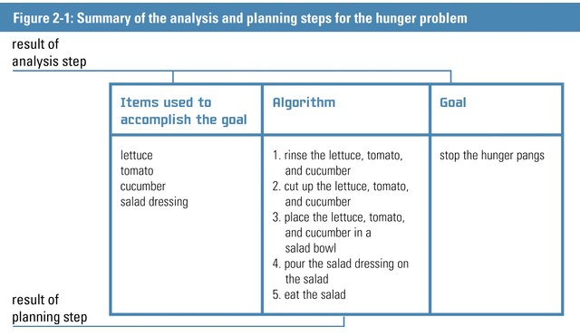
Analysis and Planning
An Introduction to Programming with C++

Slide 6
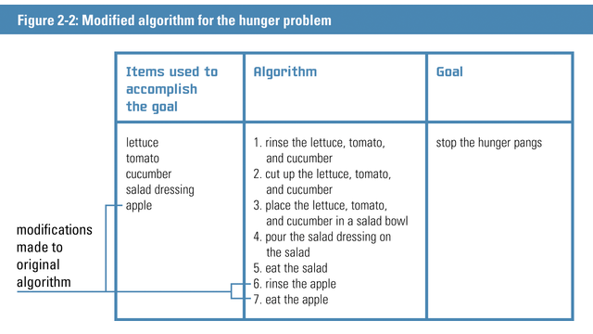
Modified Algorithm
An Introduction to Programming with C++

Slide 7
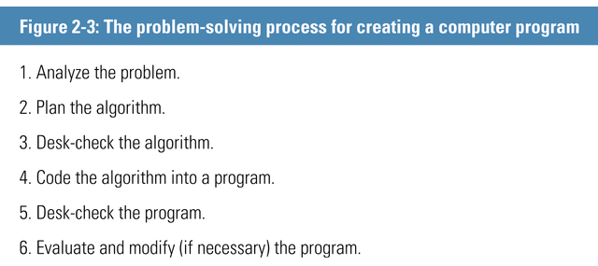
Creating Computer Solutions to Problems
An Introduction to Programming with C++

Slide 8
Analyzing the Problem
Purpose of analyzing problem:
  to determine the goal
  to determine the items needed to achieve goal
An Introduction to Programming with C++

Slide 9
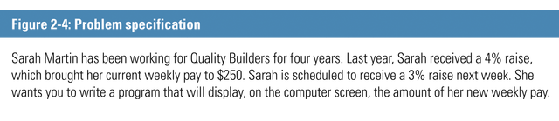
Analyzing the Problem (Cont.)
An Introduction to Programming with C++

Slide 10
IPO (Input, Processing, Output) Charts
Used by programmers to organize and summarize the results of a problem analysis
To determine input:
  Search the problem specification for an answer to the following question: What information will the computer need to know to print, display, or store the output items?
An Introduction to Programming with C++

Slide 11
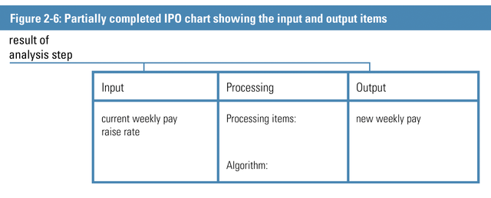
IPO Chart with Input and Output
An Introduction to Programming with C++

Slide 12
Determining Important Information
If not sure if an item of information is important, ask yourself this question: If I didn’t know this information, could I still solve the problem?
When reading a problem specification, it helps to use a pencil to lightly cross out unnecessary information
An Introduction to Programming with C++

Slide 13
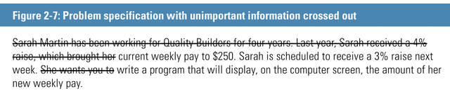
Problem Specification
An Introduction to Programming with C++

Slide 14
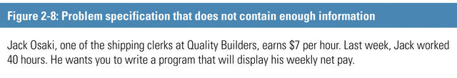
Problem Specification Lacking Information
An Introduction to Programming with C++

Slide 15
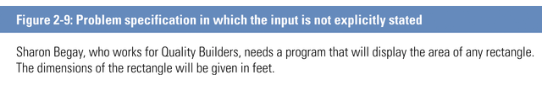
Problem Specification with Input not Stated
An Introduction to Programming with C++

Slide 16
Planning the Algorithm
Processing item - an intermediate value that the algorithm uses when processing the input into the output
Pseudocode - a tool programmers use to help them plan an algorithm
Flowchart - uses standardized symbols to show the steps the computer needs to take to accomplish the program’s goal
An Introduction to Programming with C++

Slide 17
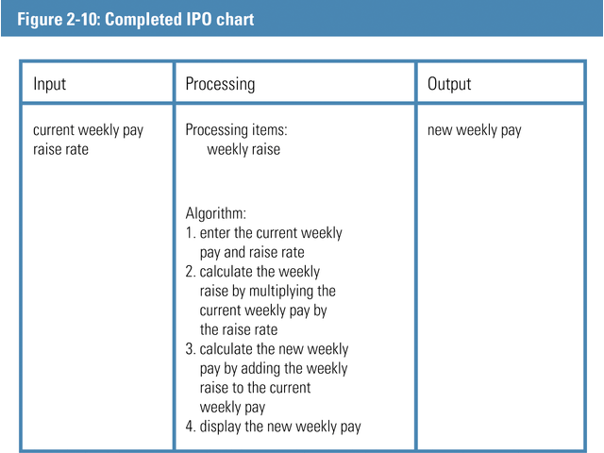
Completed IPO Chart
An Introduction to Programming with C++

Slide 18
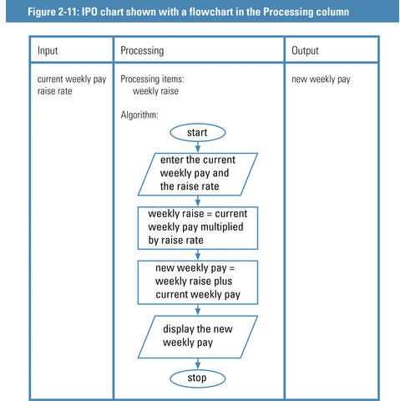
IPO Chart with Flow Chart
An Introduction to Programming with C++

Slide 19
Flowchart Symbols
Flowlines - used to connect symbols
Start/stop symbol (oval) – indicates beginning of flowchart
Process symbols (rectangles) – used to represent tasks such as calculations
Input/output symbol (parallelogram) - Used to represent input tasks
An Introduction to Programming with C++

Slide 20
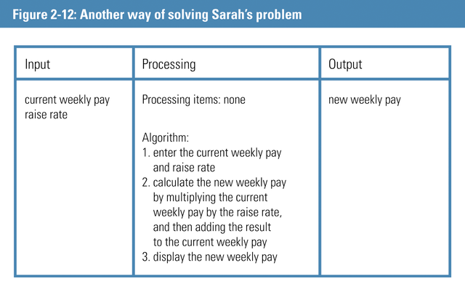
Solving Sarah’s Problem
An Introduction to Programming with C++

Slide 21
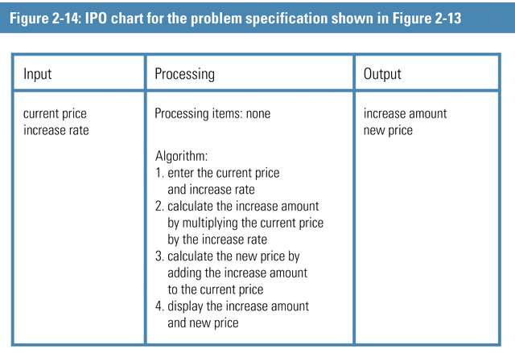
IPO Chart for Problem Specification
An Introduction to Programming with C++

Slide 22
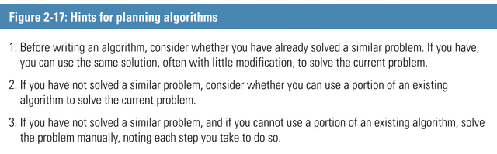
Hints for Planning Algorithms
An Introduction to Programming with C++

Slide 23
Desk-checking the Algorithm
Reason for desk-checking:
  To verify that the program is not missing any steps
  To verify that the existing steps are correct and in the proper order
An Introduction to Programming with C++

Slide 24
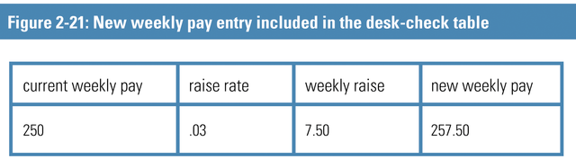
Desk-check Table with New Weekly Pay
An Introduction to Programming with C++

Slide 25
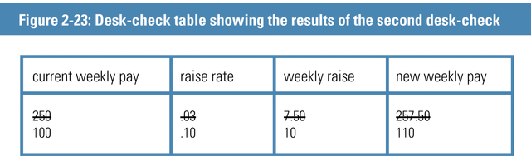
Results of Second Desk-check
An Introduction to Programming with C++

Slide 26
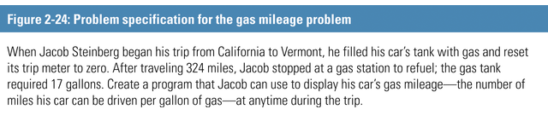
The Gas Mileage Problem
An Introduction to Programming with C++

Slide 27
The Gas Mileage Problem
Analyze the problem looking for nouns and adjectives that represent both input and output
Output should answer the following question: What does the user want to see printed on paper, displayed on the screen, or stored in a file?
Input should answer the following question: What information will the computer need to know to print, display, or store the output items?
An Introduction to Programming with C++

Slide 28
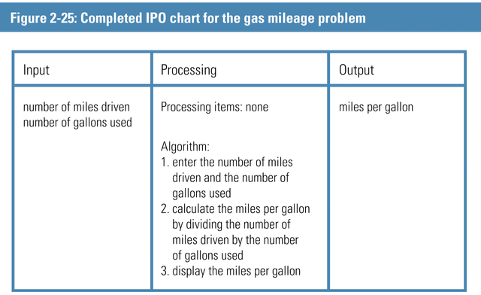
IPO Chart
An Introduction to Programming with C++

Slide 29
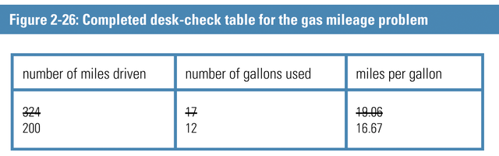
Completed Desk-check Table
An Introduction to Programming with C++

Slide 30
Application Lesson
An Introduction to Programming with C++

Slide 31
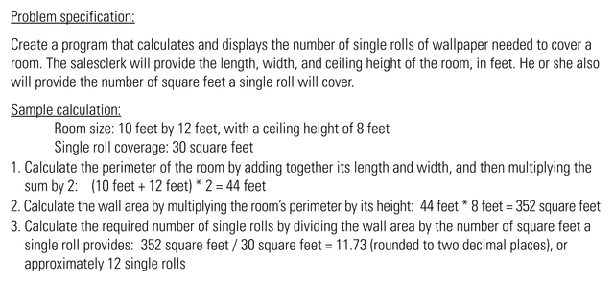
Problem Specification and Sample Calculation
An Introduction to Programming with C++

Slide 32
Analyze the Problem
Answer the following questions:
  What does the user want to see printed on the printer, displayed on the screen, or stored in a file?
  What information will the computer need to know to print, display, or store the output items?
An Introduction to Programming with C++

Slide 33
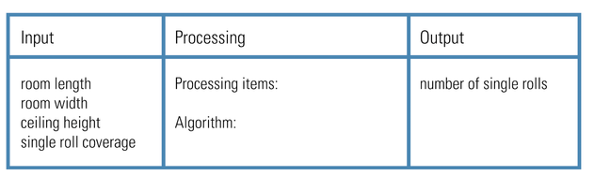
IPO Chart Showing Input and Output Items
An Introduction to Programming with C++

Slide 34
Planning the Algorithm
Algorithm – the step-by-step instructions that will transform the input into the output
Processing item - an intermediate value that the algorithm uses when processing the input into the output
An Introduction to Programming with C++

Slide 35
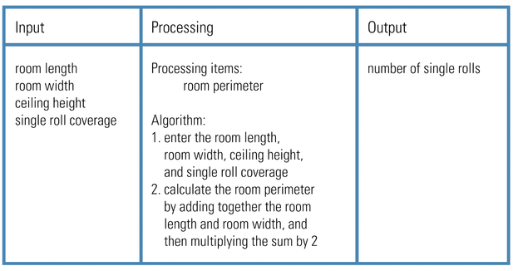
IPO Chart Showing the Partially Completed Algorithm
An Introduction to Programming with C++

Slide 36
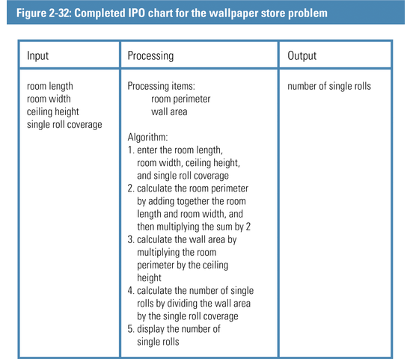
Completed IPO Chart
An Introduction to Programming with C++

Slide 37
Desk-checking the Algorithm
Before desk-checking:
  choose a set of sample data for the input values
An Introduction to Programming with C++

Slide 38
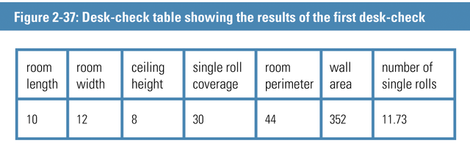
Results of First Desk-check
An Introduction to Programming with C++

Slide 39
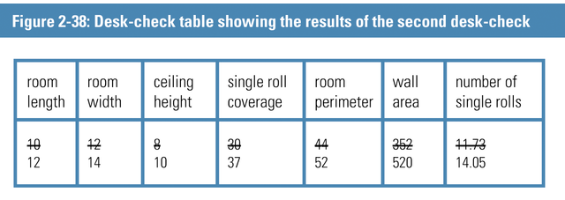
Results of Second Desk-check
An Introduction to Programming with C++

Slide 40
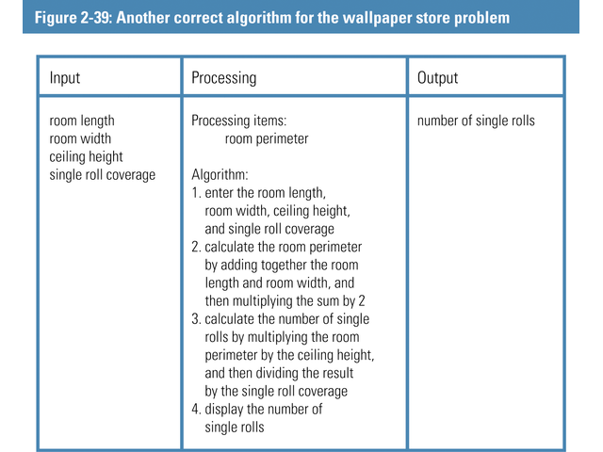
Another Correct Algorithm
An Introduction to Programming with C++

Slide 41
Summary
Explain the problem-solving process used to create a computer program
Problem analysis techniques
Complete an IPO chart
Use of algorithms (pseudocode) and flowcharts
Desk-checking techniques
An Introduction to Programming with C++

